Slide 1





List Component and Rest API JSON
Fauzi Sholichin
fauzisholih@gmail.com
+6289673732142
https://www.linkedin.com/in/fauzisho/

Slide 2
Introduction
Introduction Menu Contact (Dummy JSON)
Introduction Menu List Contact (Dummy JSON)
Provider Class

Slide 3
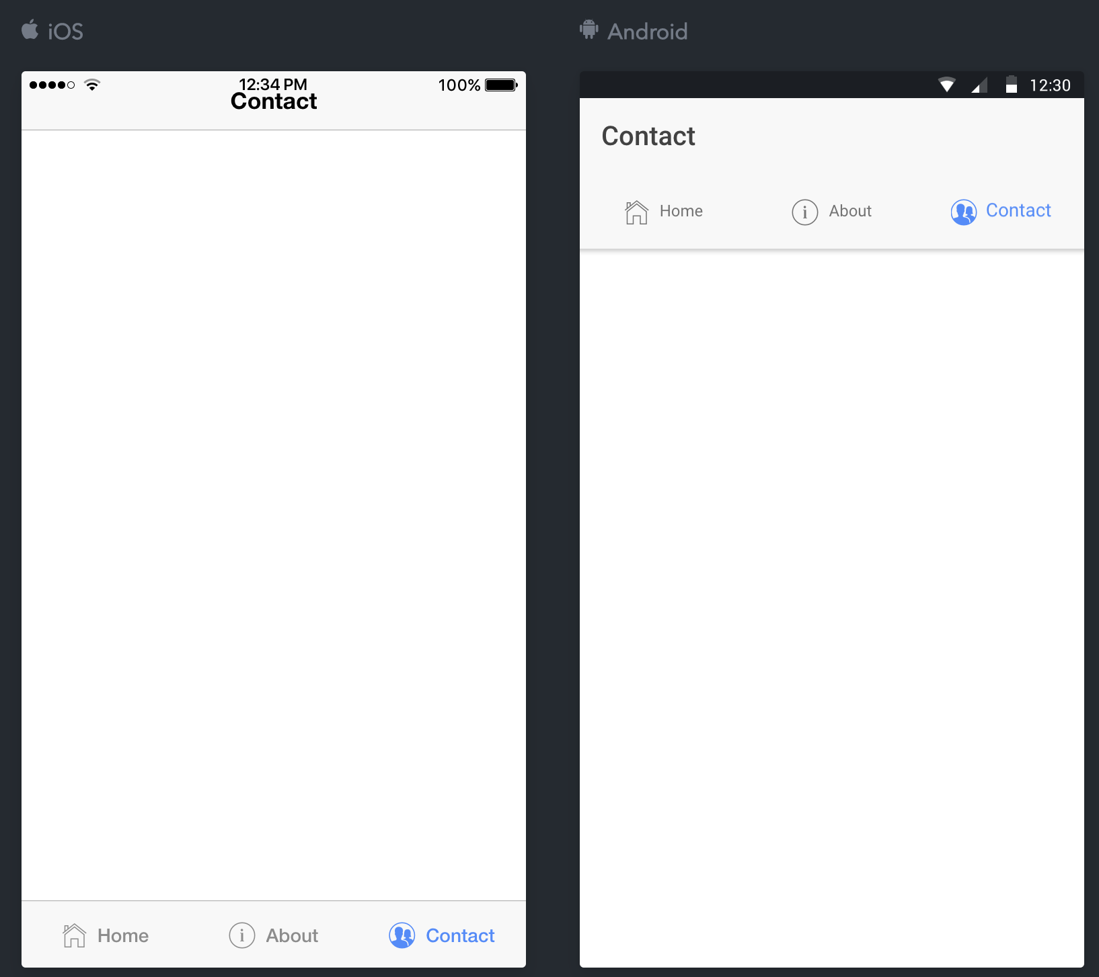
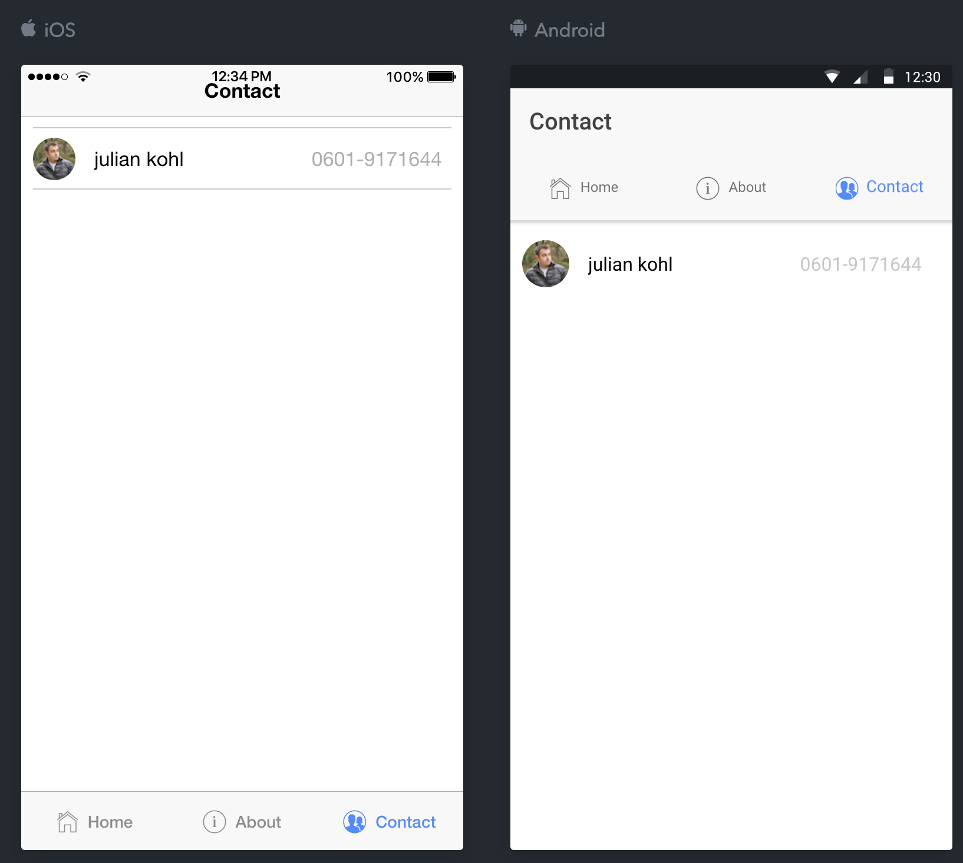
Introduction Menu Contact

Slide 4
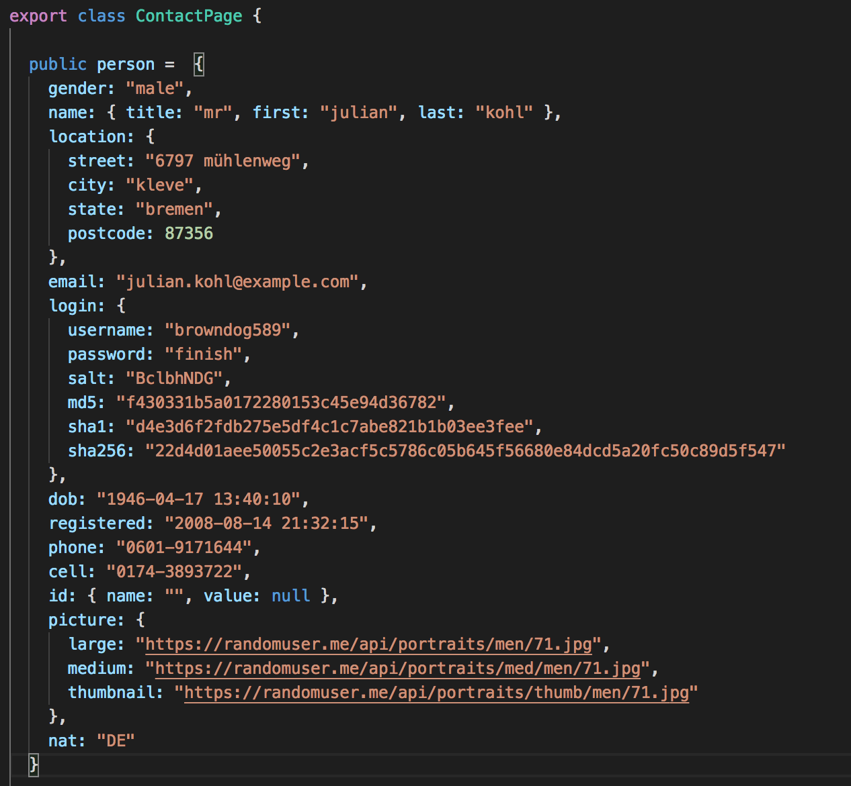
Introduction Menu Contact
contact.ts

Slide 5
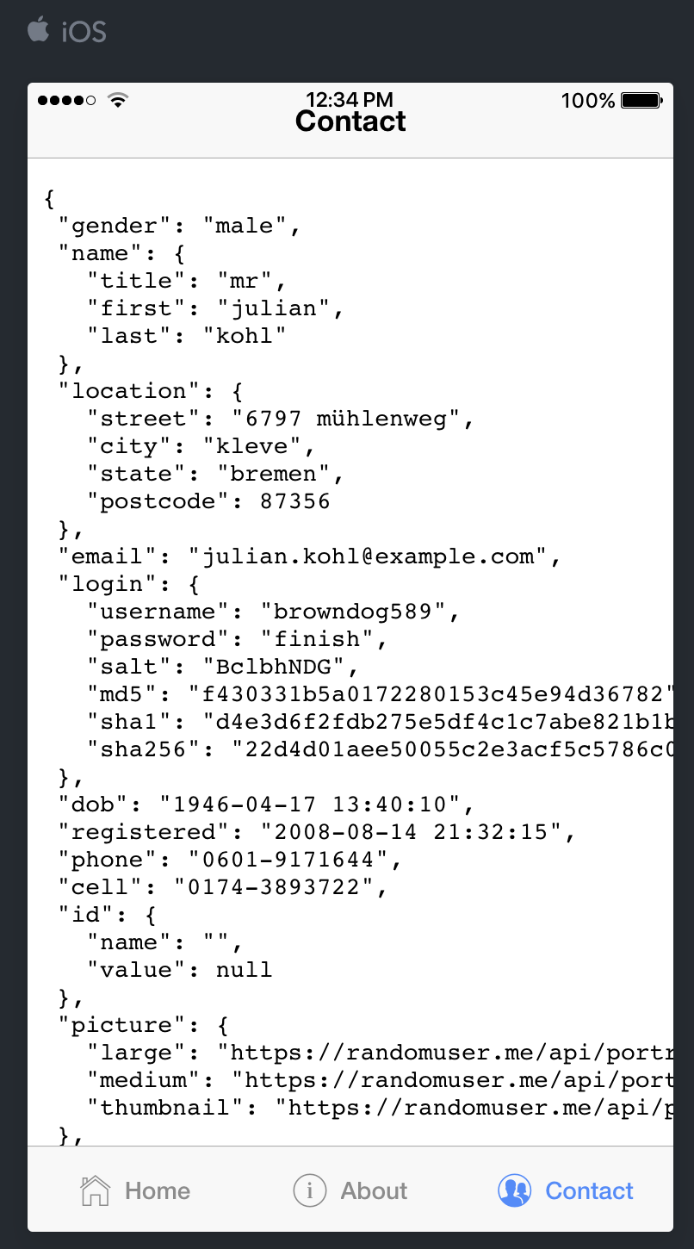
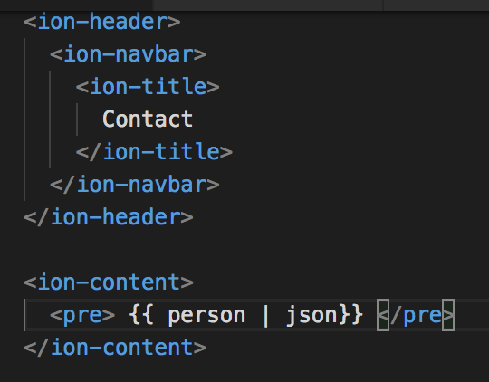
Introduction Menu Contact
contact.html

Slide 6
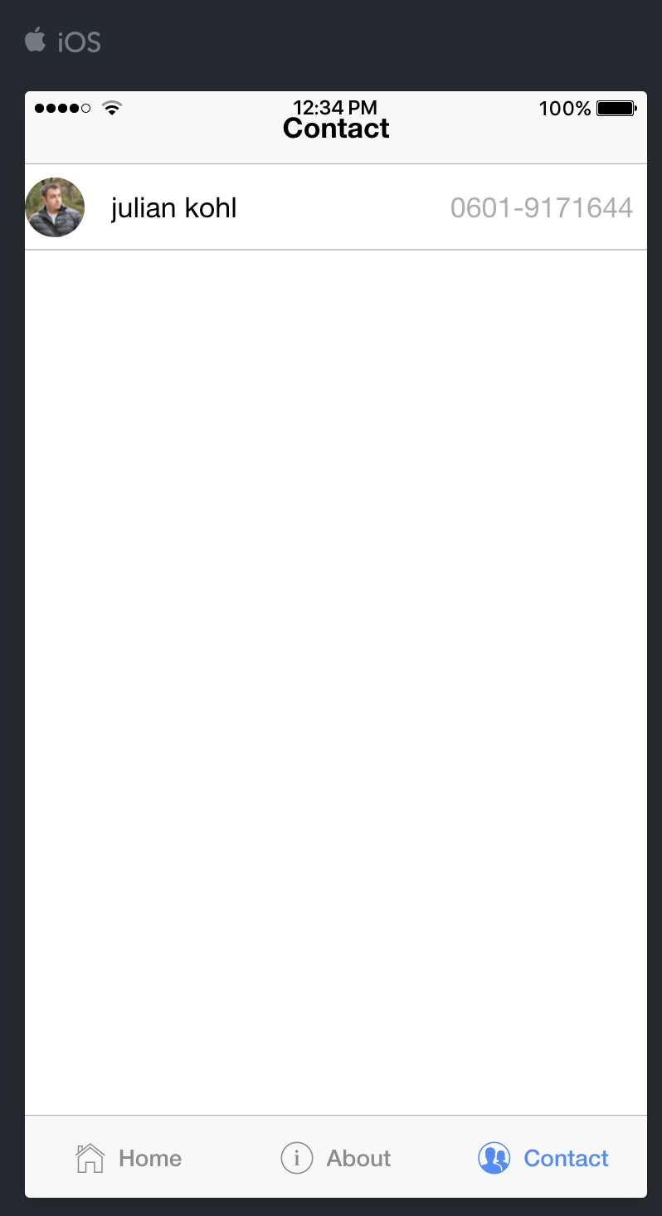
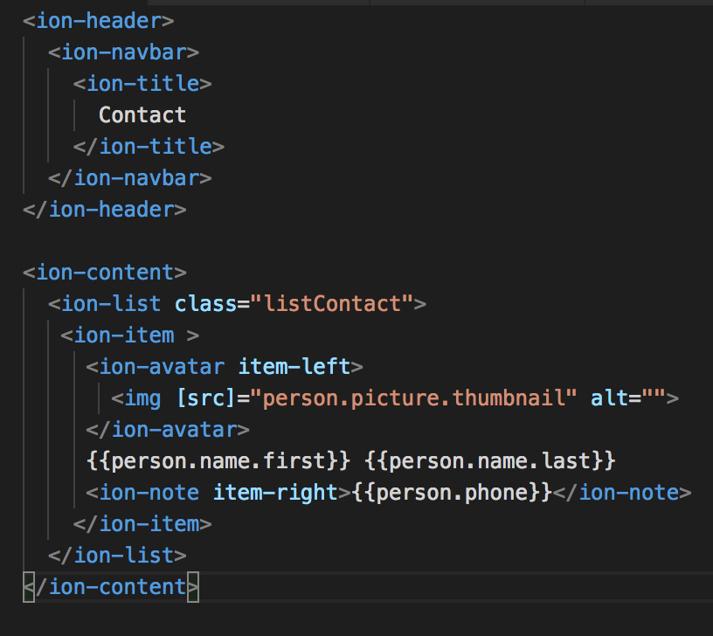
Introduction Menu Contact
contact.html

Slide 7
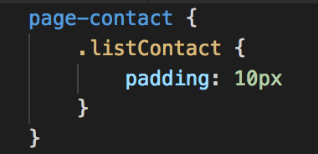
Introduction Menu Contact
contact.sass

Slide 8
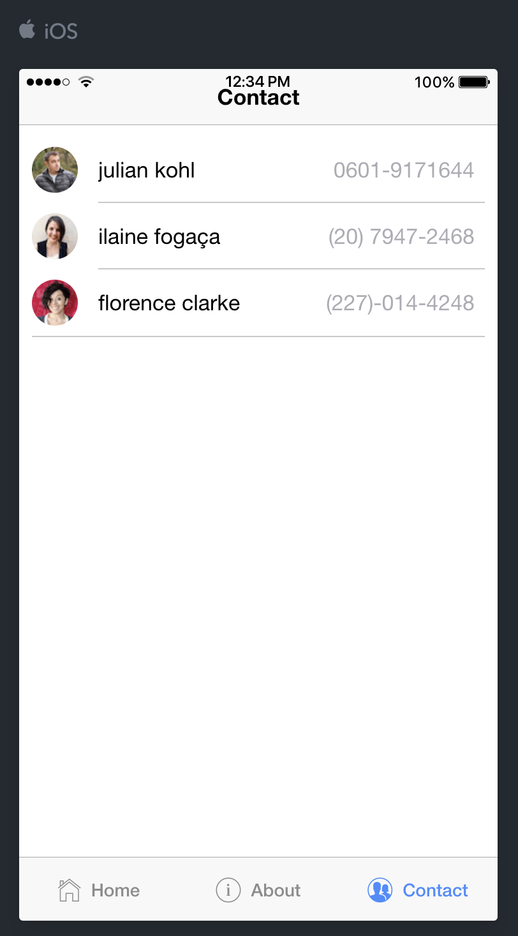
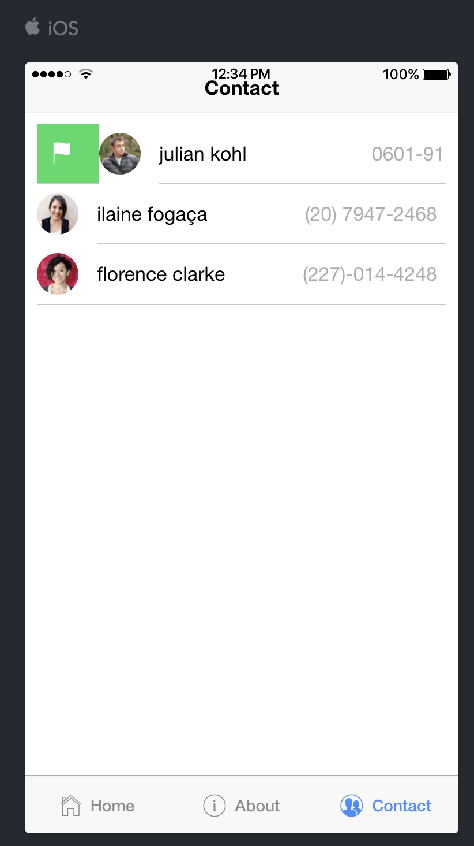
Introduction Menu List Contact

Slide 9
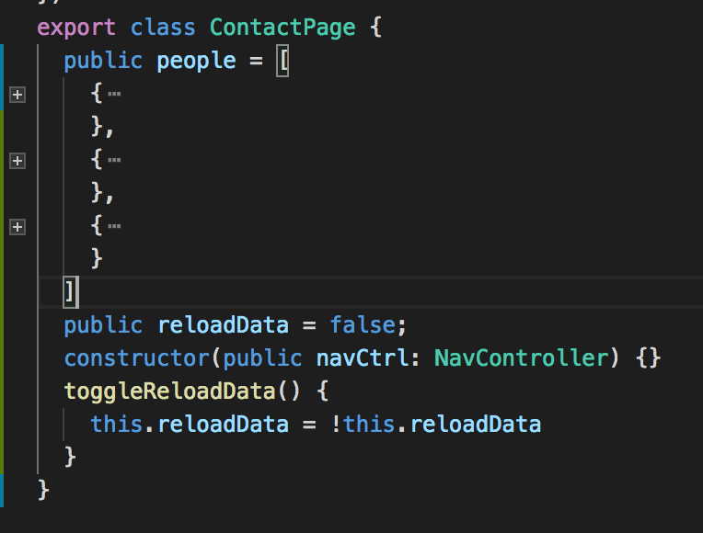
Introduction Menu List Contact
contact.ts

Slide 10
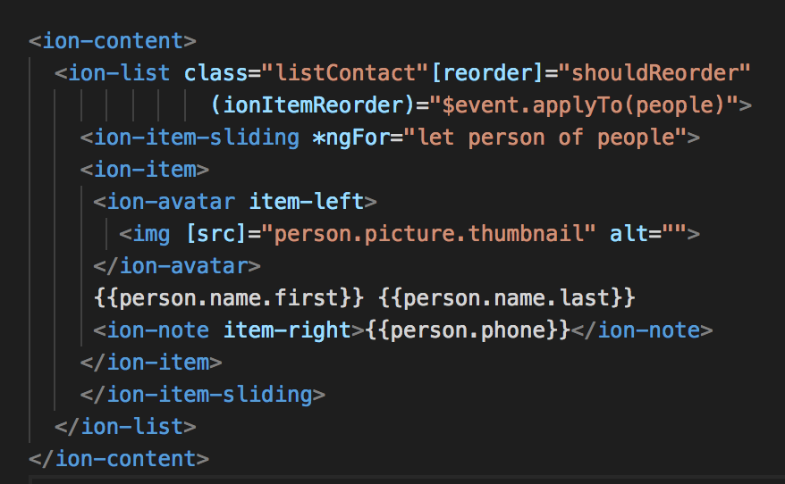
Introduction Menu List Contact
contact.html

Slide 11
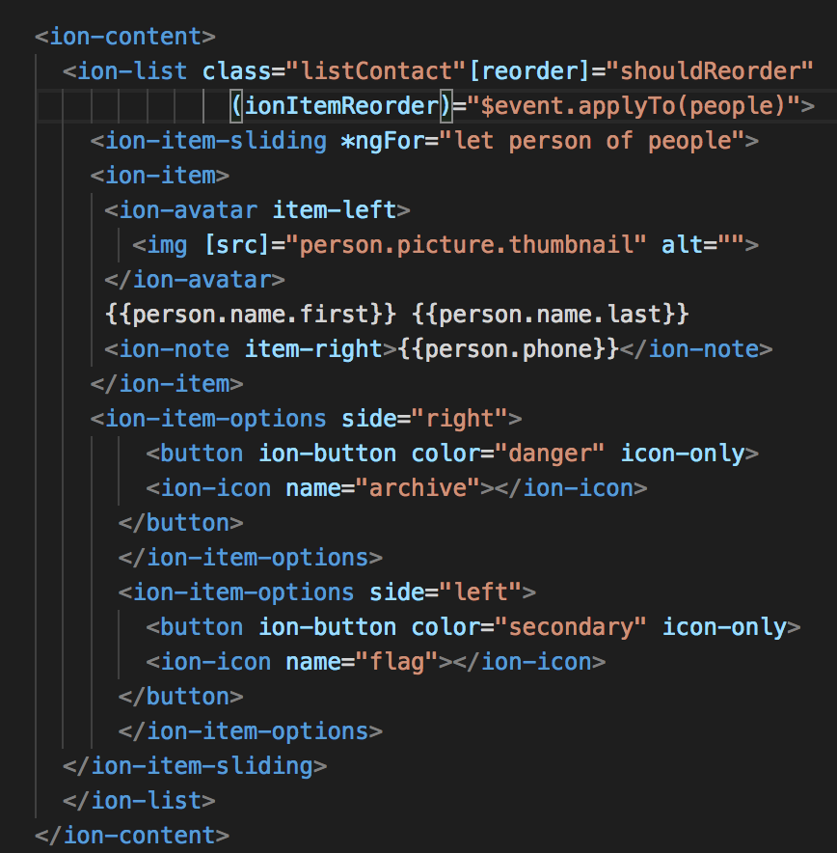
Introduction Menu List Contact
contact.html

Slide 12

Make Provider People
Open terminal CMD
ionic g provider People

Slide 13
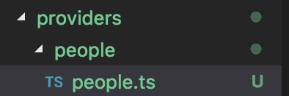
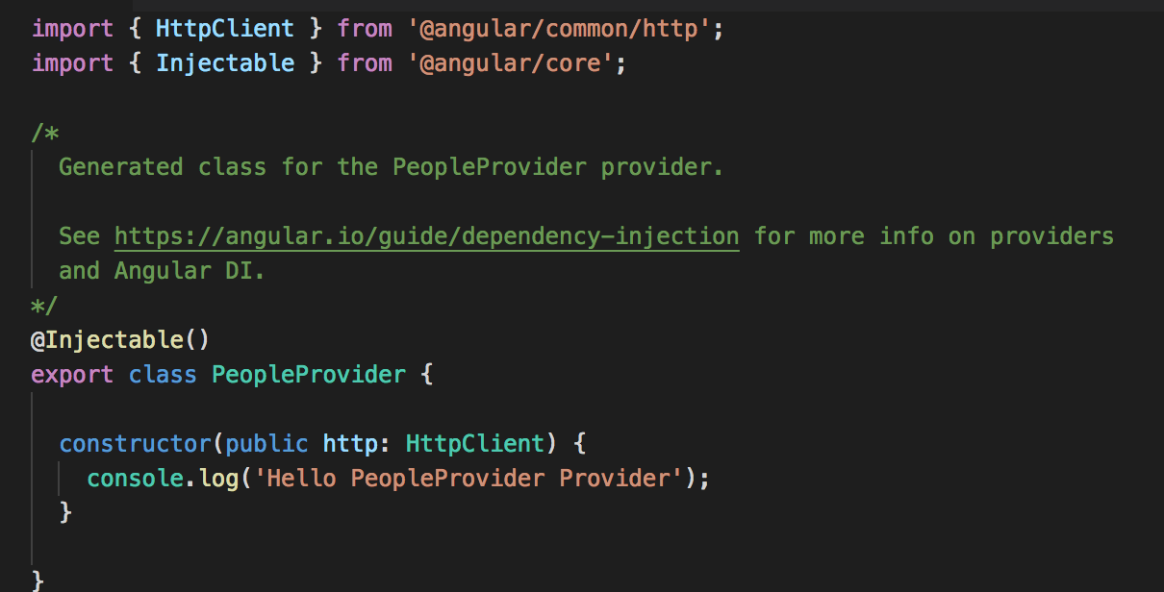
Make Provider People
Result :

Slide 14
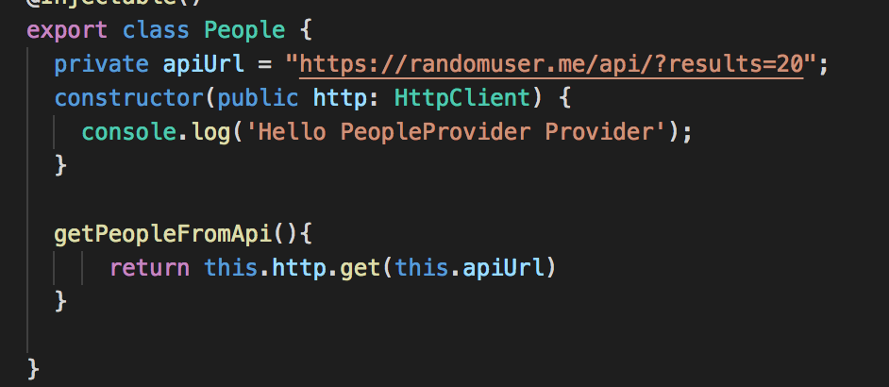
Synchronize Provider People
people.ts

Slide 15
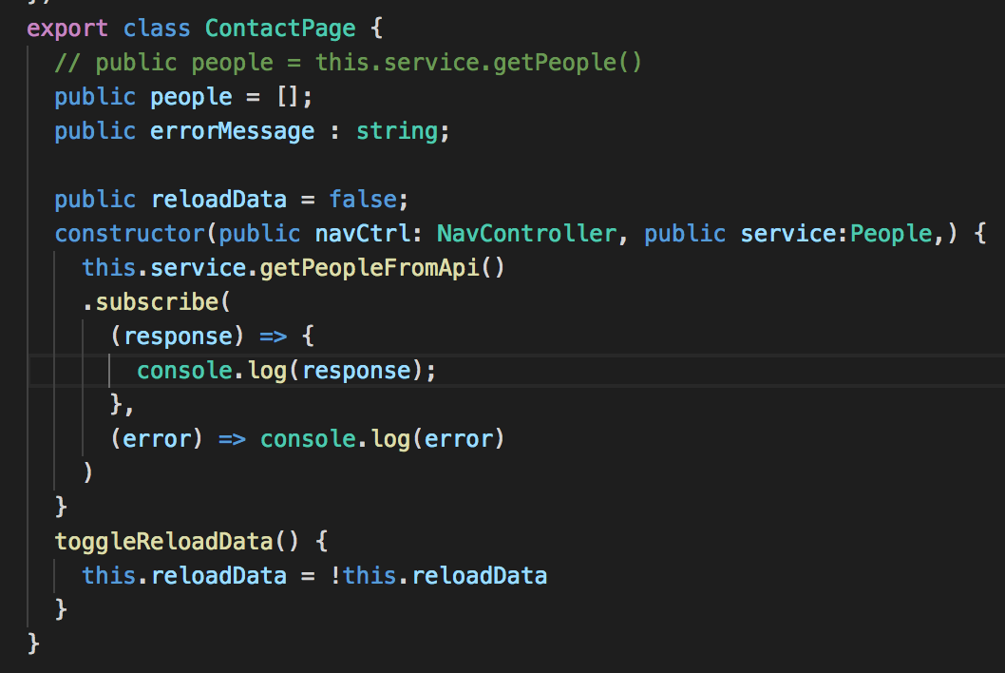
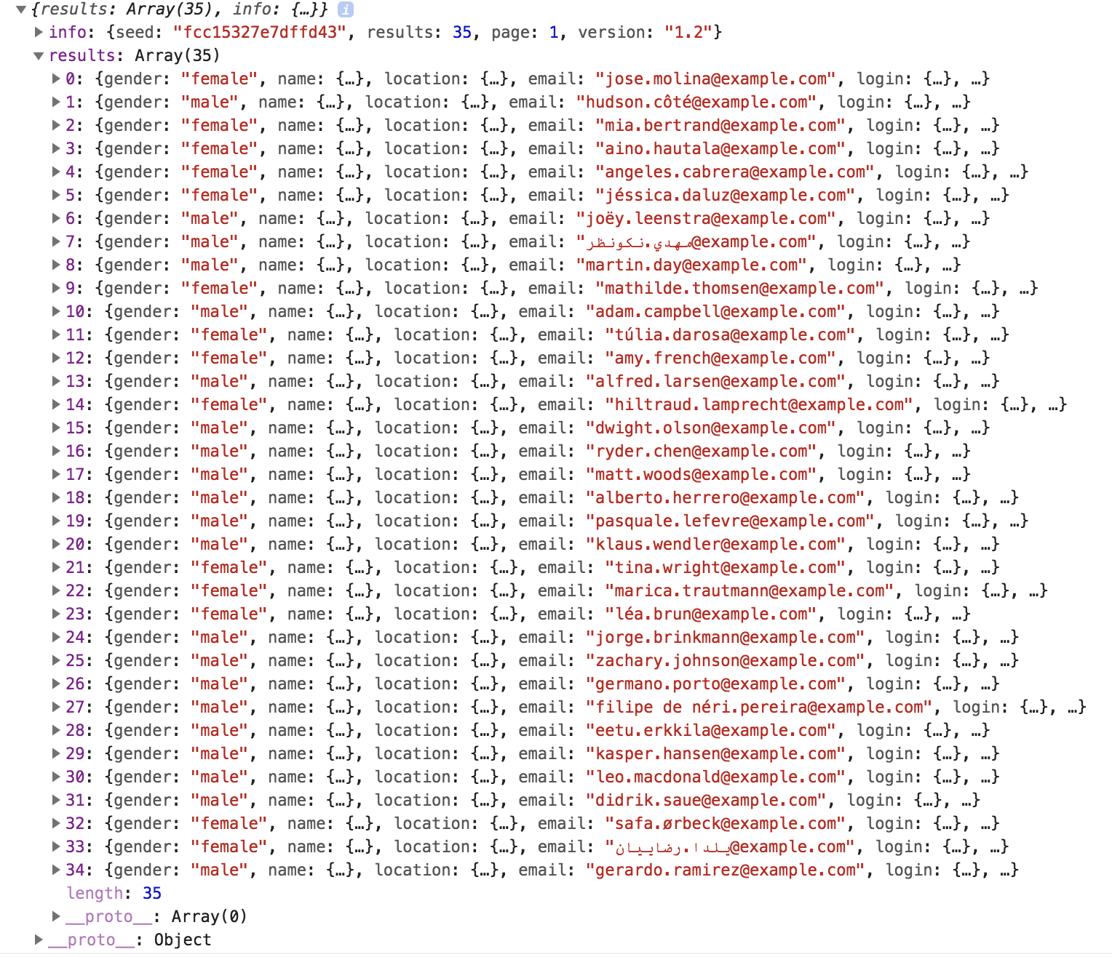
Synchronize Provider People
contact.ts
console :

Slide 16
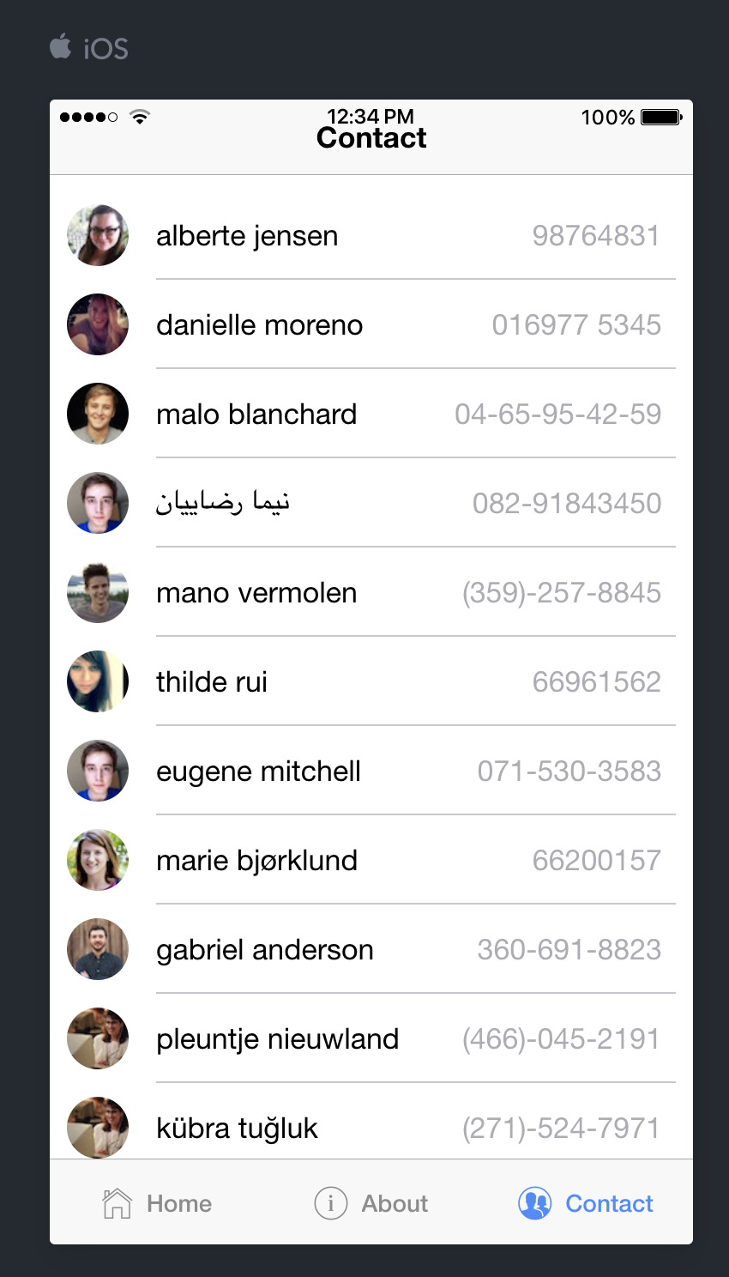
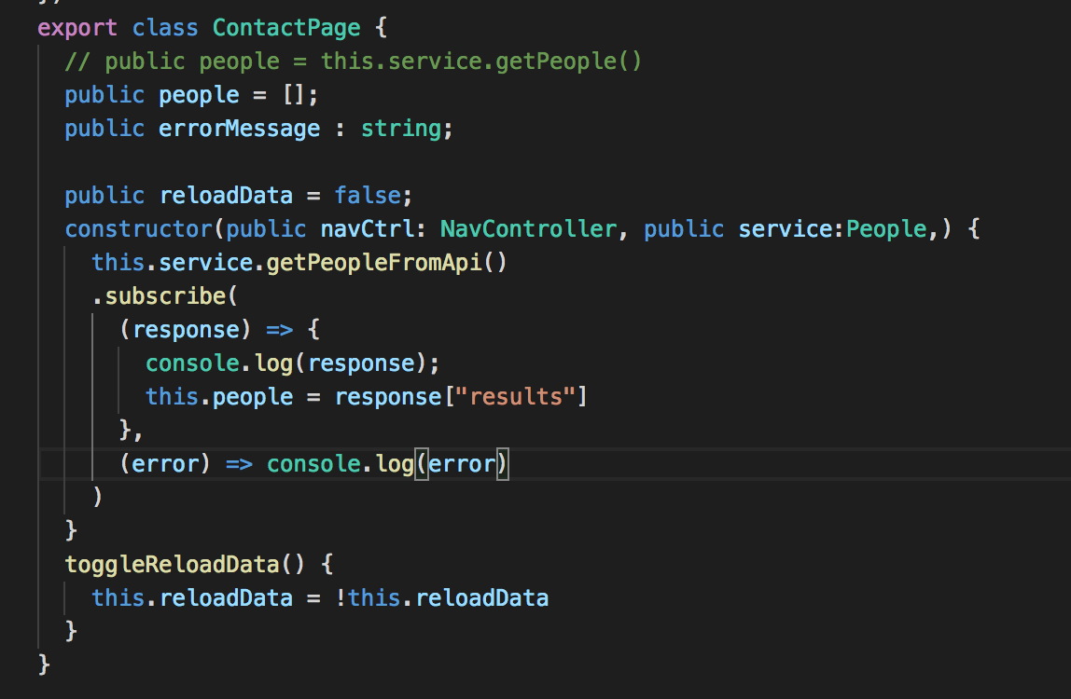
Synchronize Provider People
contact.ts
Notes:
// infinity scroll
// open profile
//

Slide 17
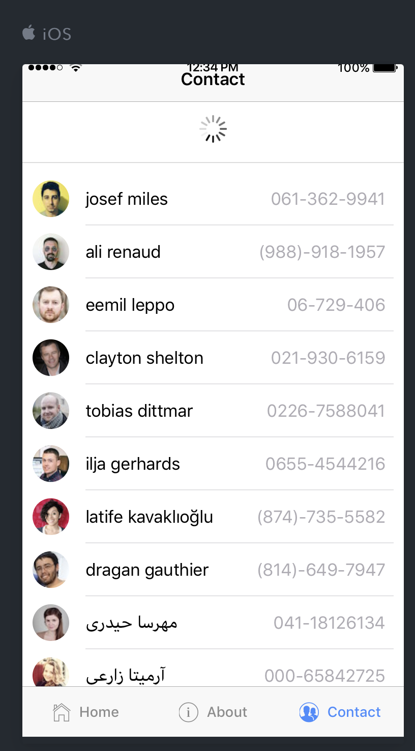
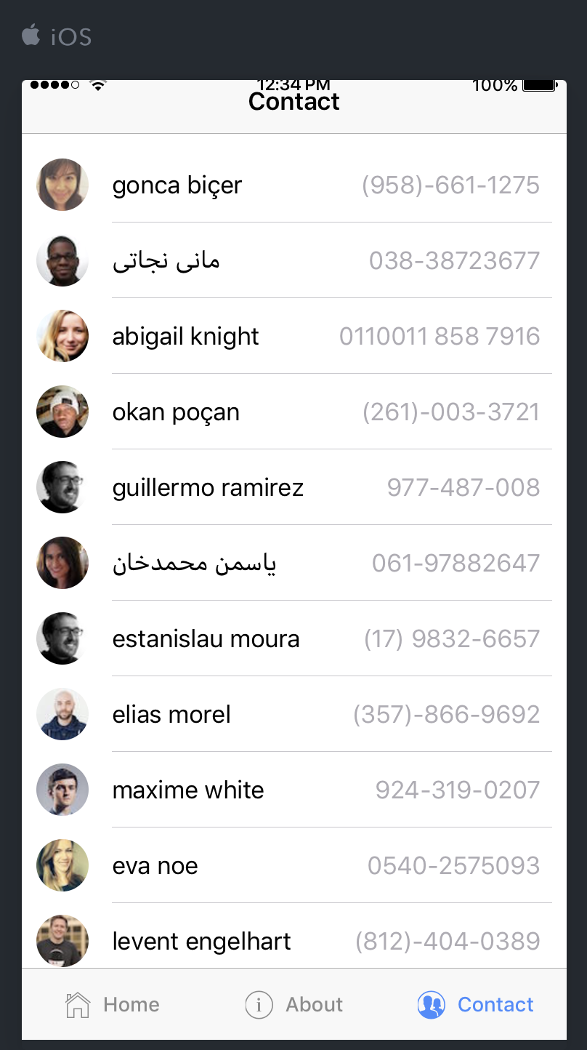
Refresh List

Slide 18
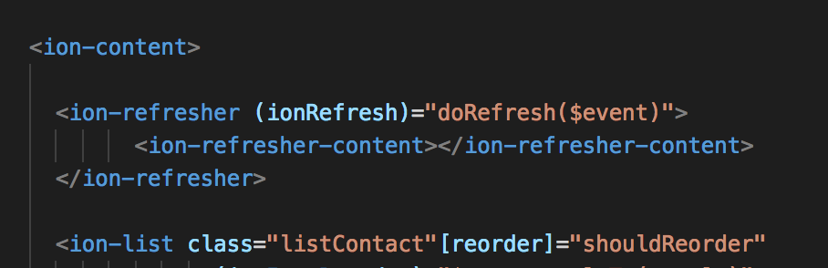
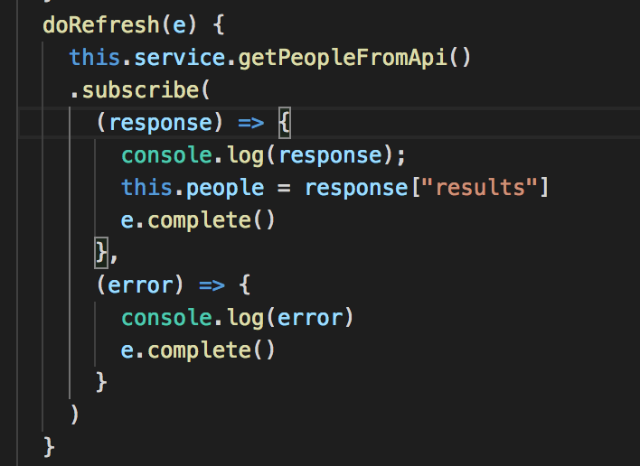
Refresh List
contact.html
contact.ts

Slide 19
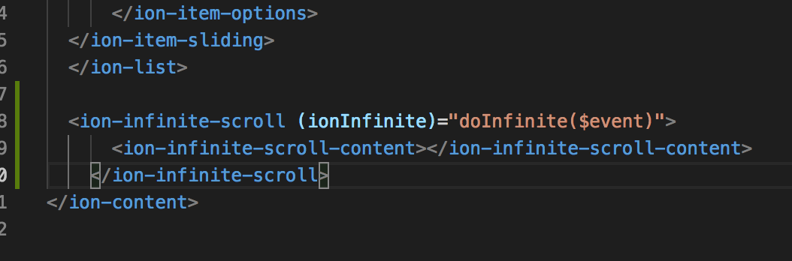
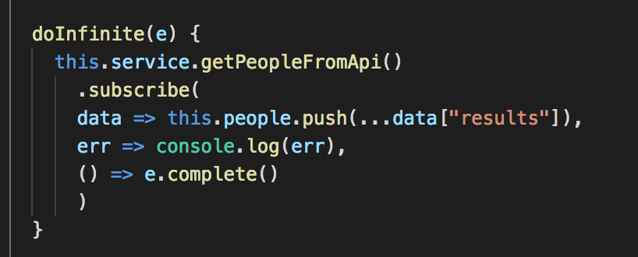
Infinite List
contact.html
contact.ts

